Slide 1
Artefact testing (AKA Experimentation / Results)
Alix Bergeret

Slide 2
Learning Outcomes
By the end of this session you will be able to:
explain key artefact testing stages.
explain the difference between qualitative and quantitative data.
explain key principles of questionnaire design.
apply artefact testing principles to your own research project.

Slide 3
Artefact Testing
You will be testing your artefacts with regards to your academic question and aims.
This is different from functional testing.
You still need to make sure your artefact works before you test it with regards to your academic question and aims.
You typically don’t need to include any details of your functional testing in your academic report.
Speak to your supervisor if you have any questions.
This is an important part of the project.

Slide 4
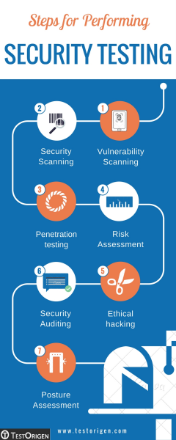
Artefact Testing
You will be testing your artefacts with regards to your academic question and aims.
What you do and the type of data you collect will depend on your project.
For example, if your academic question is about “web security”, you will need to perform security testing.
https://www.testorigen.com/steps-performing-security-testing/

Slide 5
Artefact Testing
You will need to analyse the execution of your artefact, gather data on its outcome and evaluate the results.
There are three general steps:
Gathering data.
E.g. run tests / experiments, questionnaires, semi-structured interviews.
Analysing the data.
Preparation.
Presentation.
Interpretation.
Evaluate the results of the analysis.
Source: Success in Your Project: a guide to student system development projects. ISBN-13: 978-0273678090.

Slide 6
Artefact Testing
How you go about these three general steps for your artefact testing generally defines your projects research methodology.

Slide 7
Research Methodology
Method/Methodology – Generally, a method represents a procedure or technique used to carry out a process in a systematic way.
Research Methodology.
Gathering data.
(Potentially) formulating a hypothesis or proposition.
Testing the hypothesis / academic question.
Analysing the data.
Evaluate the results of the analysis.
Source: Planning and implementing your final year project - with success! : a guide for students in computer science and information systems. ISBN-13: 978-1852333324.

Slide 8
Hypothesis
Your research question can be further refined into a hypothesis.
Speak to your supervisor if you feel this may be useful.
You do not necessarily need an hypothesis.
An hypothesis is a short statement on the relationship between two or more variables.
An hypothesis is a guess / hunch that you want to explore / answer.
An hypothesis typically indicates an answer to a problem, which you then test.
You then verify the hypothesis via your experimentation.
Example:
“When agents behave more dynamic and less predictable, the game-play will be improved.”
https://www.aaai.org/Papers/Workshops/2007/WS-07-01/WS07-01-001.pdf

Slide 9
Research Methodology - Types of Data
One of the most important methodology choices is the type of data you are going to collect.
Broadly, there are two types of data.
Qualitative data.
Opinions, textual feedback, descriptions.
Quantitative.
data that can be measured, e.g. measure of time, number of visits etc.
Take the form of numbers.
Which do you need?

Slide 10
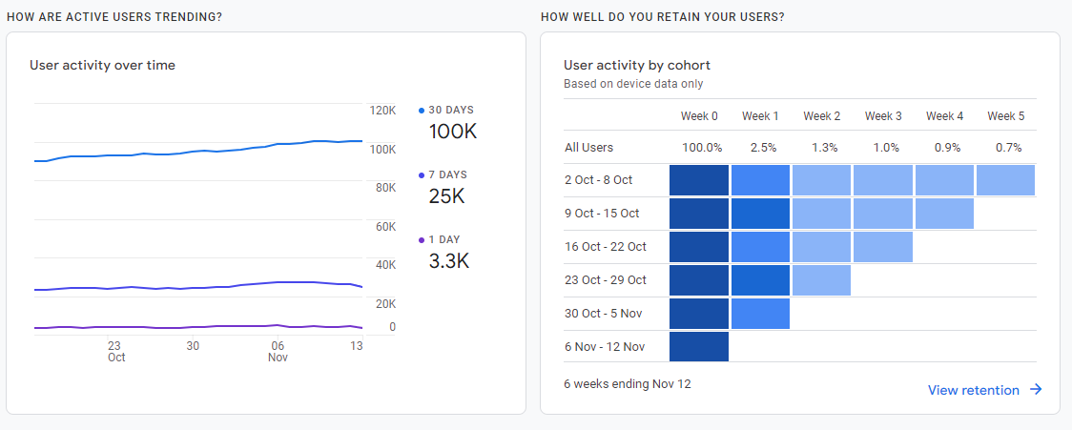
What sort of data is this?

Slide 11
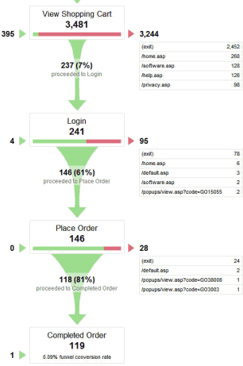
Types of data - quantitative
Quantitative data tells you what is happening, not why, e.g.:
This screen is slower than that one
Visitors are only staying 5 seconds on this page
Customers are not spending as much money on the new site
This type of data can often be collected:
Automatically via tools, e.g. Google Analytics, Heat maps, mouse/eye tracking, automatic testing frameworks etc.
Via user feedback, e.g. scaled questions.

Slide 12
Types of data - qualitative
Qualitative data looks at the why.
Why are you not staying on this page?
Why is this algorithm slower than that one.
How?
Heuristic analysis: an experience-based assessment of your artefact run by an expert (you?), based on an evaluation framework. (source)
User surveys and interviews. Writing unambiguous, unbiased open questions can be very difficult though. Also processing this data will be time consuming.
Think-aloud methodologies.

Slide 13
Design
Surveys / Questionnaires.
A/B testing.
Two versions (A and B) of a single variable are compared.
Simulation data (e.g. run game and see how an artificial intelligence (AI) performs).
You would collect data that documents how the AI performs. This data can then be analysed statistically.
Interviews
Structured?
Unstructured?
Semi-structured?

Slide 14
Questionnaires
Questionnaires are a good way to gather data.
However, a badly designed questionnaire can result in unusable data or no responses.
Tips:
What do you want to know?
Who should you ask?
Your questionnaire should be clear and well presented.

Slide 15
Questionnaires
Types of question.
Open – respondent can use their own words.
Closed – has limited options for the respondent.
Minimise bias in questions.
Avoid leading questions.
Example: Did you like my excellent software?
A more neutral question: How would you rate the new software?
Also, people answer questions based on their perception of the question. Again, a neutral question will make it easier to answer.
Be specific and avoid jargon.
Think about the options for your closed questions.
Survey scale.
Example: Likert scale.
5 or 7-point scale. Measures attitudes.
For example:
not at all satisfied, slightly satisfied, moderately satisfied, very satisfied, and completely satisfied.
Notes:
Likert scale – measure attitude.
Bias – ask if broken the law, could be rephased. For example, felt under pressure to drive over speed limit in order to keep an appointment.

Slide 16
Questionnaires
Examples:
While playing, I learned about the subject I expected to learn about from the game. | Strongly Agree | Agree | No Opinion | Disagree | Strongly Disagree
I think the game mechanics reflect similar real-world situations | Strongly Agree | Agree | No Opinion | Disagree | Strongly Disagree
I find the game to be both fun and educational | Strongly Agree | Agree | No Opinion | Disagree | Strongly Disagree
Examples Source:
https://eprints.soton.ac.uk/419472/1/JB_ThesisFinal.pdf

Slide 17
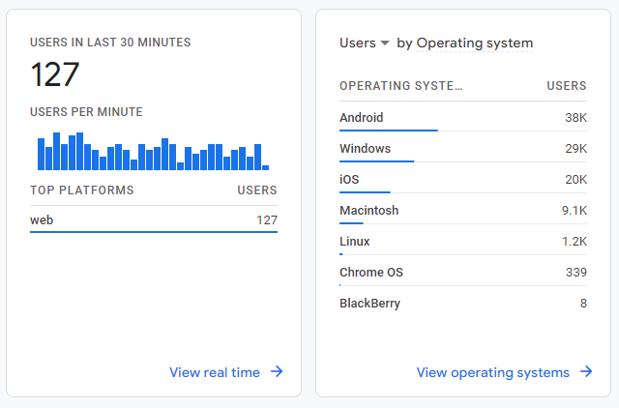
Presenting Numerical Data
Tables.
Graphs.
Line.
Bar.
Pie.
Avoid misleading graphs.

Slide 18
Example
Let’s do an example together.
My research question is: “How can I make websites more usable?”
How could I test that I have achieved the above?

Slide 19
Summary
By the end of this session, you will be able to:
explain key artefact testing stages.
explain the difference between qualitative and quantitative data.
explain key principles of questionnaire design.
apply artefact testing principles to your own research project.
Learning outcomes?
Any questions?

